Slide 1
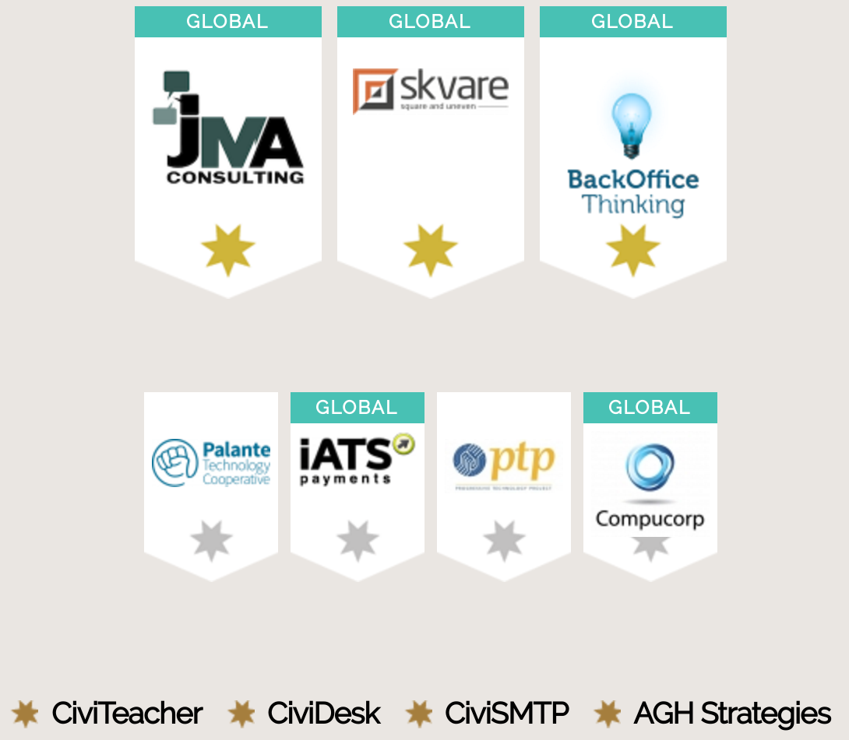

Slide 2
CMS Showdown

Slide 3
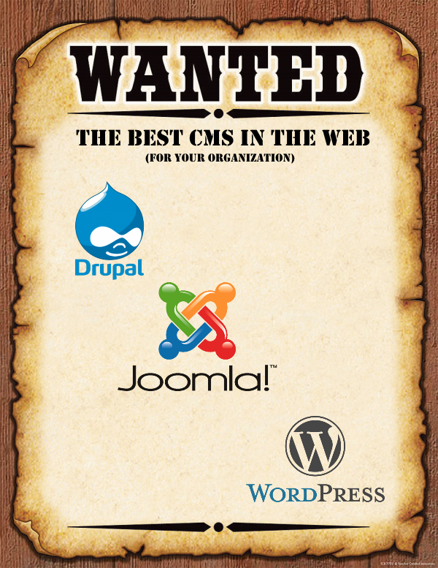

Slide 4
What Is A Content Management System (CMS)?
CMS
Website Content
Outside Content
Connections with CRM
Programs
Statistics and Research
Social Media
So Much More

Slide 5
CMS Landscape
There are hundreds of CMS’s to choose from but only three currently work with CiviCRM
Of the many CMSes many are written in different computer languages and do different things well
The three we will look at are all written in a language called PHP
There are open source and closed source CMSes, the three we will look at are all open source

Slide 6
Our Contenders

Slide 7
The Similarities
All are free and open source
All are written in PHP
All run well on LAMP stack
Large communities for support
Many vendors offering support
All work with CiviCRM

Slide 8
Installation
Drupal
Joomla
WordPress
Must have access to the file system and setup a database
Simple step-by-step process
Must have access to the file system and setup a database
Simple step-by-step process
Must have access to the file system and setup a database
Simple step-by-step process
A lot of hosting companies have 1-click installs to make it easier

Slide 9
Design
Drupal
Joomla
WordPress
Calls the design a theme
Hundreds of free themes
Many low cost themes available
Nearly unlimited potential for themeing
Calls the design a template
Some free templates
Many low cost themes available
Nearly unlimited potential for themeing
Calls the design a theme
Many free themes
Many low cost themes available
Nearly unlimited potential for themeing

Slide 10
Mobile
Drupal
Joomla
WordPress
Current version does not have out of the box mobile support
New version (8) will have out of the box mobile support
Many mobile friendly/adaptive themes available
No mobile support out of the box
Mobile friendly/adaptive themes available
Mobile support out of the box
Mobile apps for site management
Mobile friendly/adaptive themes available

Slide 11
CiviCRM and Mobile
CiviCRM does not have native mobile support for the front end or the back end
You will want to budget time in your themeing if you want front end form to work well with mobile

Slide 12
Content Editing Features
Drupal
Joomla
WordPress
Current version does not have out of the box WYSIWYG editing
Pluggable WYSIWYG editing able to be installed
New version (8) will have out of the box WYSIWYG editing
Ships with WYSIWYG editing out of the box
Ships with WYSIWYG editing out of the box

Slide 13
Content Version Control
Drupal
Joomla
WordPress
Out of the box versioning of content
Many modules expand on version control
Out of the box versioning of content
Plugins available to expand on version control
Does not ship with versioning of content
Paid plugin available for version control

Slide 14
Content Flexibility
Drupal
Joomla
WordPress
Simple display out of the box
Views module allows for display of content in many different ways
Views will ship with Drupal 8 out of the box
Many modules for creating versatile displays of content
Simple display out of the box
Limited plugins for changing content display
Very blog centric out of the box
Ability to create pages
Views style plugin available for sale

Slide 15
Editorial Workflows
Drupal
Joomla
WordPress
Published/ Unpublished out of the box
Modules provide versatile workflows
Provides several content states out of the box
Modules are available to expand workflows
Workflow for content review comes out of the box
Modules are available to expand workflows

Slide 16
Media Management
Drupal
Joomla
WordPress
Powerful media module available for installation
Excellent flexibility for media management
No one solution for managing media especially in older versions
Built in image management solution
Plugins available to expand on media management
Wonderful drag and drop media manager ships with WordPress
A highlight of the WordPress out of the box experience
Modules available to extend media management features

Slide 17
Comments
Drupal
Joomla
WordPress
Good comment support out of the box
Many modules available for adding functions like comment notifications
Connects with common comment services
No comments support out of the box
Plugins available for comment support
Comment support out of the box
Many modules available for adding functions like comment notifications
Connects with common comment services

Slide 18
SEO
Drupal
Joomla
WordPress
Somewhat SEO friendly out of the box
Many modules available for making Drupal play well with SEO
Not very SEO friendly out of the box
Build to be very SEO friendly out of the box
Lots of plugins to help with even more SEO

Slide 19
Social Media
Drupal
Joomla
WordPress
Many modules available for adding social sharing and connections with social media sites
Plugins available for adding social sharing and connections with social media sites
Many plugins available for adding social sharing and connections with social media sites

Slide 20
Community Building
Drupal
Joomla
WordPress
Powerful modules for providing community building functionality
Some plugins for providing community building functionality
Many plugins for providing community building functionality

Slide 21
Search
Drupal
Joomla
WordPress
Drupal default search is good
Many modules to enhance search
Replacements for Drupal search like Apache SOLR for large sites
Joomla default search is good
Plugins available to enhance search
Replacements for Joomla search like Apache SOLR for large sites
WordPress default search is good
Plugins available to enhance search
Replacements for Joomla search like Apache SOLR for large sites

Slide 22
Multilingual Functionality
Drupal
Joomla
WordPress
Many translations of core and contributed modules
Limited multilingual support in core
To do multilingual well you need several contributed modules
Out of the box ability to work in multiple languages
Many translations (localizations) of WordPress
No out of the box multilingual support
Paid plugins available

Slide 23
Module/Plugin Availability
Drupal
Joomla
WordPress
Thousands of free modules of various quality
If modules do not come from Drupal.org use caution
Many plug-ins are sold rather than available as open source
Many free plugins of various quality
Many plugins have paid versions

Slide 24
eCommerce
Drupal
Joomla
WordPress
Powerful eCommrce suite called Drupal Commerce
Hundreds of modules that add onto to Drupal Commerce
Used for non-standard commerce applications
Less popular options also available in the ecosystem
Paid modules available for adding commerce functionality
Modules available for commerce
Many modules work together for a strong environment
Commerce options focused around standard products

Slide 25
User Management
Drupal
Joomla
WordPress
Easy to create users
Granular permissions makes managing permissions somewhat of a challenge
Many modules to change and enhance user management and experience
Easy to create users
Limited permissions out of the box
Plugins available change and enhance user management and experience
Easy to create users
Several levels of users available out of the box
Plugins available change and enhance user management and experience

Slide 26
Administration
Drupal
Joomla
WordPress
Steep initial learning curve
End users do not need to administer settings
Middle of the road learning curve
End users do not need to administer settings
Less to administer out of the box
Some would argue this is because it is less flexible
End users do not need to administer settings

Slide 27
Security
Drupal
Joomla
WordPress
Considered to be strong security
Security depends greatly on configuration
Security team helps make sure published code is secure
Always install security updates!
Considered to be strong security
Security depends greatly on configuration
Always install security updates!
Considered to be strong security
Security depends greatly on configuration
Always install security updates!

Slide 28
Community
Drupal
Joomla
WordPress
Drupal has a very strong global community
Community sometimes known for favoring developers but this is being actively worked on
Boulder/Central & Southern Meetups
Drupal Camp Colorado in June
Global community
Joomla! Users Colorado
Very open community
Access for all levels of users
Denver WordPress Meetup
Word Camp Denver in June

Slide 29
CiviCRM Integration
Drupal
Joomla
WordPress
Most active ecosystem of CiviCRM integration modules
Drupal Views support, sync support, and Drupal rules all come with CiviCRM
Webform CiviCRM is very popular
Limited ecosystem of CiviCRM extensions specifically for Joomla
No Joomla modules specifically for CiviCRM
Lots of active development
Great features like Short Code insertion for CiviCRM pages
New WordPress plugins being developed for CiviCRM

Slide 30
Vendor Landscape
Drupal
Joomla
WordPress
Many local vendors
Many large vendors around the world
Many vendors do Drupal and CiviCRM integrations
Some local vendors
Many vendors around the world
Many local vendors
Many vendors around the world
Many companies that do not know about web design offering services with stock templates

Slide 31
Determining The Right CMS
What are we trying to accomplish?
What kind of content will we have?
Do we need commerce?
What advanced functions do we need?
Who will be administering the system?
How many users will use the site?
What is our workflow?
What is our budget?
What vendor do we want to use?

Slide 32
More Resources
A Consumers Guide To Content Management Systems For Nonprofits - Idealware
CiviCRM user and administrator guide - Choosing your CMS
Many articles on the Internet
Notes from today’s session will be posted on the session page for CiviCon

Slide 33
Creative Commons
This work is licensed under a Creative Commons Attribution-ShareAlike 3.0 Unported License.

